Slide 1
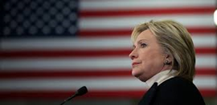
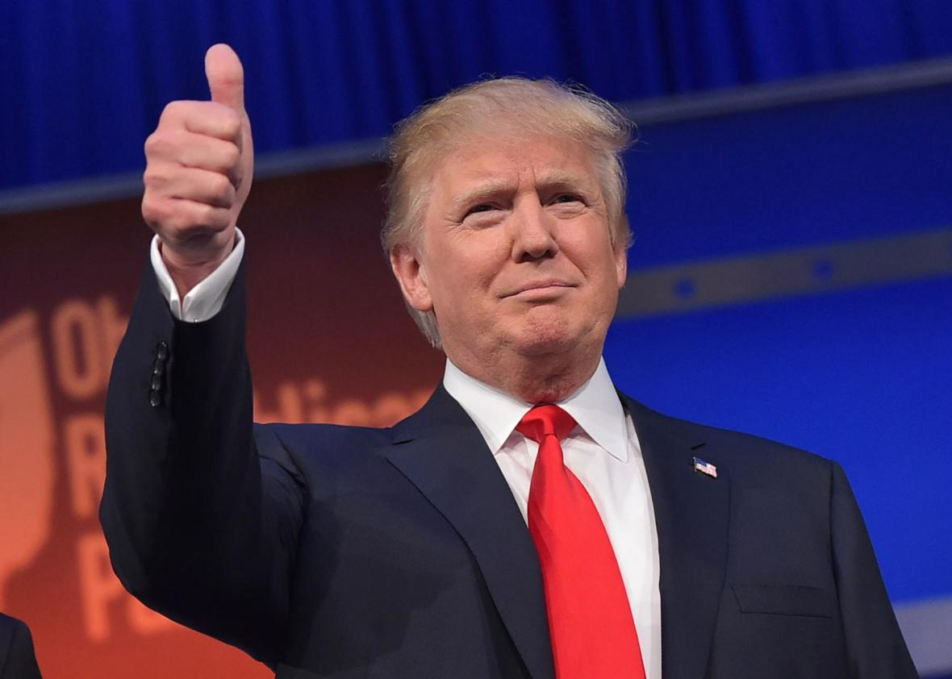
HOW IS THE PRESIDENT ELECTED?
The Road To The White House

Slide 2
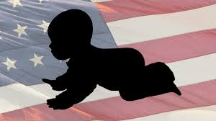
1. Requirements for government job
At least
35 years old
Natural born
US citizen
US resident
since 14 years
Spring / Summer
2015
2. Candidates announce their plans to run for president
3. Candidates begin campaigning. They give speeches and they learn what voters care about

Slide 3
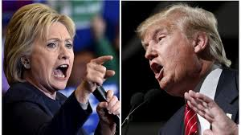
4. Candidates take part in debates. They give their views on issues.
5. Candidates take part in primary elections and caucuses.
Summer
2016
6. During conventions, just two aspirants are chosen for the “final”:
a democratic candidate
a republican candidate
September / October 2016
Both candidates debates before the final vote.

Slide 4
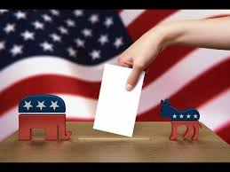
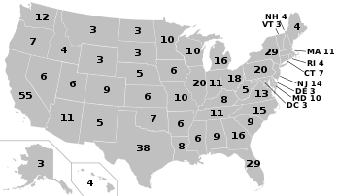
7. The vote for president:
In each state, the number of electors depends on the numbers of districts and senators.
Candidate wins the total state’s numbers of electors
The number of districts is based on population:
e.g. California: 53 Kansas: 4
In November one of the two candidates is elected and becomes the new president.
8th of November
2016

Slide 5
What do parties stand for?
Democratic party
Republican party
Oldest existing political party
They are referred to as « The Party of the people »
Federal government should take a more active role in people’s live
Formed in 1854
Less government spending on social programs
Federal government should not play a big role in people’s live
Immigrants, blue-collar workers, women & minorities

