Slide 1
PRIMARIES: people elect the candidates for each party
CONVENTIONS:
meetings where candidates announce their candidacy
PRESIDENT
INAUGURATION:
victory speech
ELECTIONS: citizens vote

Slide 2
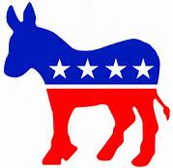
DEMOCRATS
REPUBLICANS
bearing arms must be limited and controled
For Obama care
more taxes for rich people but less taxes for poor people.
Legalize immigrant workers
Less taxes
less welfare
Against Obama care
Bearing arms for each american citizen
expulsion of immigrants

Slide 3
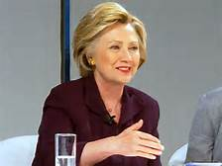
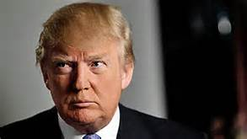
Hillary Clinton
Donald Trump
She was born on October 26,1947, in Chicago. She is the first woman to be nominated by a major party for president of US. Her husband was president of US from 1993 to 2001.
He was born on June 14, 1946, in New-York. He is a business man. He presented a famous TV show named « The Apprentice ».

